Slide 1

Network Infrastructure Redesign
Atomic synergistics
Jesse Frazier III
Notes:
Hello, my name is Jesse, and today I’m excited to walk you through my complete redesign of Atomic Synergistics’ network infrastructure. This project began with a clear goal: to replace a disorganized, outdated system with something scalable, secure, and easy to manage as the company continues to grow.

Slide 2
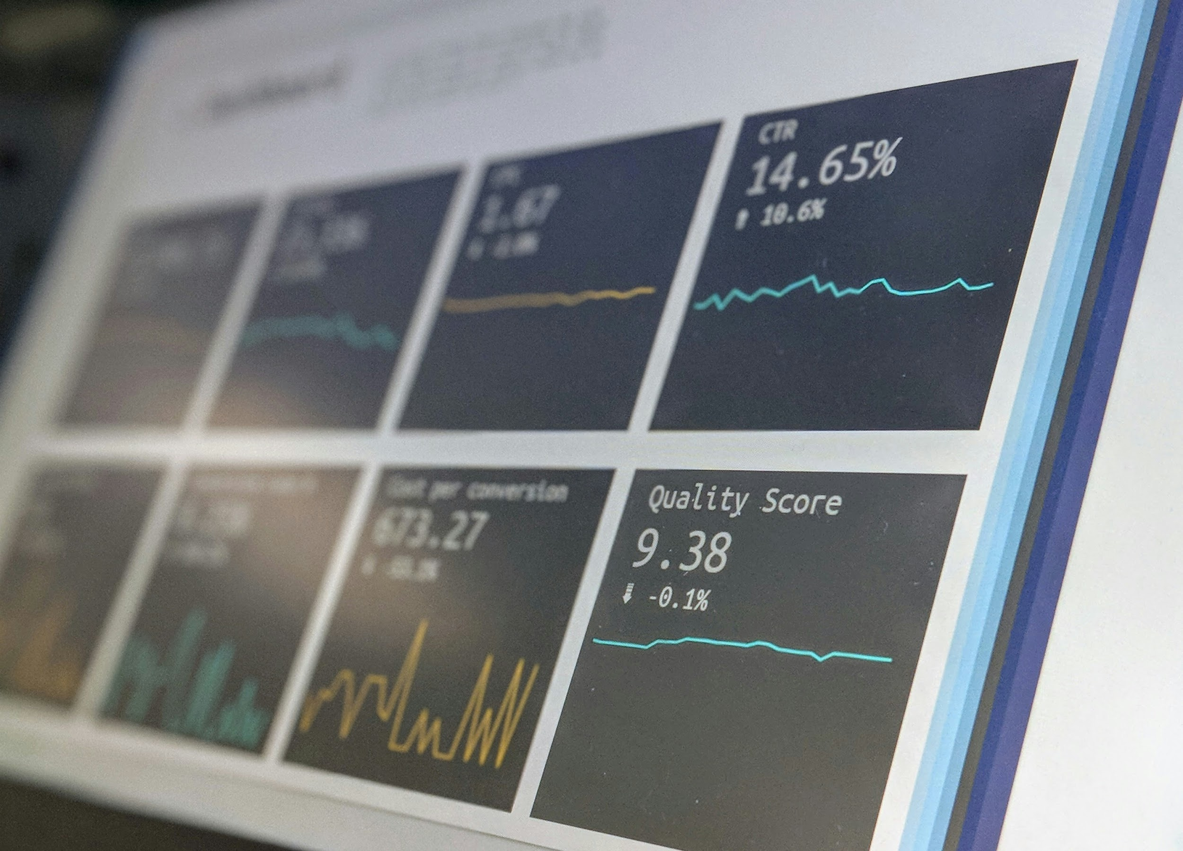
The problem
Growth Needs structure.

Slide 3
Project overview
Atomic Synergistics is a fast-growing business development firm.
Team doubled in size after a major contract with Walmart+.
Existing network couldn’t keep up — cluttered, inconsistent, and outdated.
A full redesign is underway to support scalability, security, and control.
Notes:
Atomic Synergistics is a business development firm founded in 2018 by Jeremiah Atom.
Their mission is to help businesses solve complex problems in marketing, logistics, sales strategy, and scalability.
After winning a high-profile contract with Walmart+, the team expanded rapidly, now sitting at 60 employees with plans to double within a year.
The company’s current network infrastructure could not keep up with this growth — leading to disorganization, hardware failures, and serious scalability issues.
This project proposes a complete network redesign to support Atomic’s next phase of growth — focused on performance, centralized management, security, and future-proofing.

Slide 4
Current network issues
Disorganized cabling and unventilated server closet
Failing hardware and outdated consumer-grade devices
Weak Wi-Fi and fragmented networks
No central management or domain integration
Notes:
The original network design was never built for scalability — expansion was reactive, not strategic.
The server room was relocated to a non-ventilated closet, leading to heat and cable chaos. No cable trays or labeling exist. Not showing the pictures, geneva convention joke.
Most networking gear — like the Netgear Nighthawk and ASUS routers — were consumer-grade and are now physically damaged or unsupported.
Wi-Fi was patched together with multiple independent routers. Signal strength is weak, and networks are isolated.
Only the first 25 users were domain-joined. The rest of the company relies on unmanaged laptops and external drives, making central control impossible.
The setup has become a liability — slowing productivity, creating vulnerabilities, and offering no foundation for future growth.

Slide 5

The solution
Strong foundations scale further.

Slide 6
Hardware Strategy
Reused Hardware
New Hardware
2× Dell PowerEdge R640 Servers
1× HPE ProLiant DL180 Gen10
15× Dell XPS 15 Laptops
Dell OptiPlex 7020 SFF
Dual 24" 1080p monitors
Dell D6000S docking station
Notes:
Reused 2× Dell PowerEdge R640 and 1× HPE DL180 Gen10 servers
Kept 15 Dell XPS 15 laptops for lighter-use staff (e.g. HR, sales)
New standard workstation: Dell OptiPlex 7020 SFF (i5-14500, 16GB RAM, 512GB SSD)
Each user gets dual 1080p monitors and a Dell D6000S dock
Balanced reuse with upgrades to reduce cost, ensure consistency, and simplify IT support

Slide 7
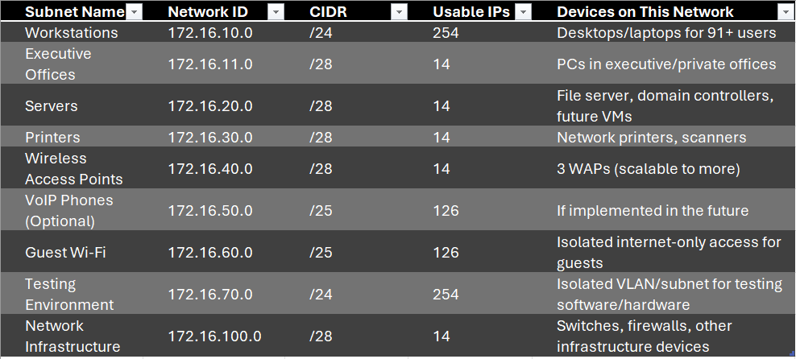
Subnetting
Notes:
Used 172.16.0.0/16 private address space for future-proofing
Separate subnets for each department/device type (workstations, execs, WAPs, servers, etc.)
Guest Wi-Fi is isolated; test lab has its own VLAN and /24 subnet
Segmentation improves performance, enhances security, and simplifies troubleshooting

Slide 8
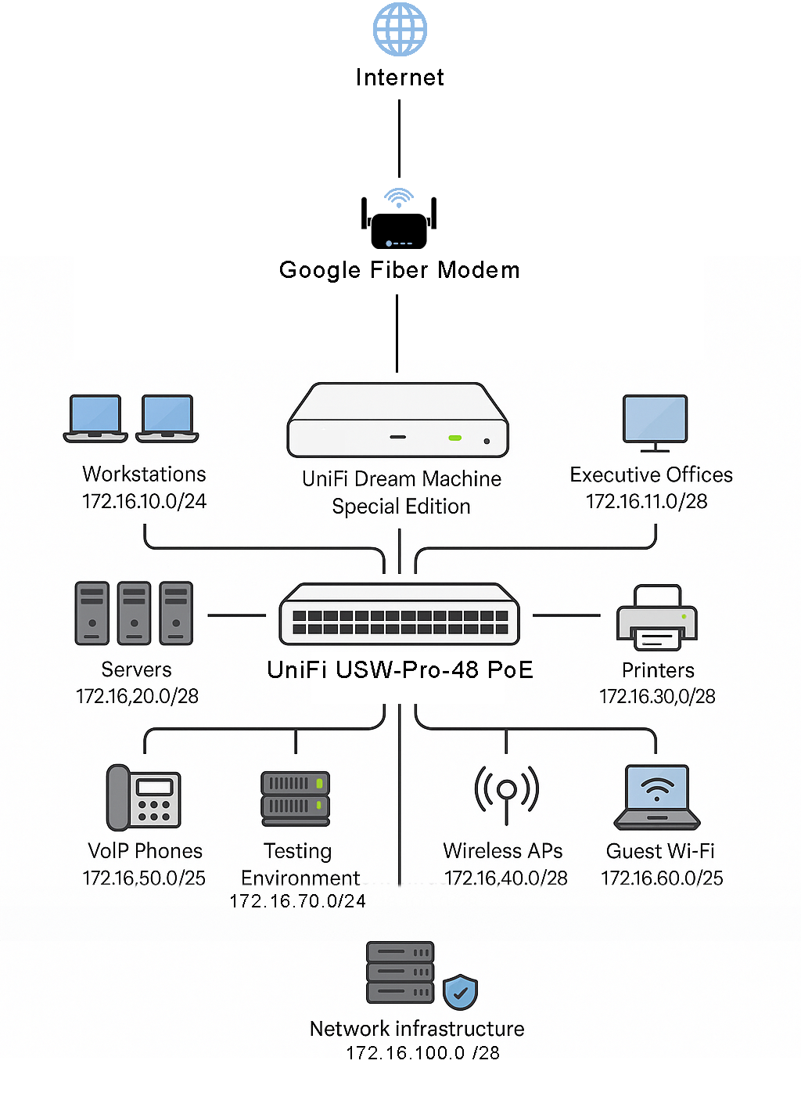
Network equipment & Design
Router/Firewall
UniFi Dream Machine SE (UDM-SE)
All-in-one with VLANs, DPI, IDS/IPS
Switching:
UniFi USW-Pro-48 PoE
48 PoE+ ports, Layer 3, SFP+ uplinks
Wireless Access Points
UniFi U6 Pro (×3) — Wi-Fi 6
Centrally managed, ceiling mounted
Cabling:
AT6a Plenum — 10 Gbps, future-proof
Notes:
Router/firewall: UniFi Dream Machine SE (VLANs, IDS/IPS, DPI, centralized management)
Core switch: UniFi USW-Pro-48 PoE (48 PoE+ ports, Layer 3, SFP+ for expansion)
3x UniFi U6 Pro access points (Wi-Fi 6, ceiling-mounted)
Cabling: CAT6a plenum-rated (10 Gbps, safe for ceilings, future-ready)
All hardware from Ubiquiti for centralized, standardized deployment

Slide 9
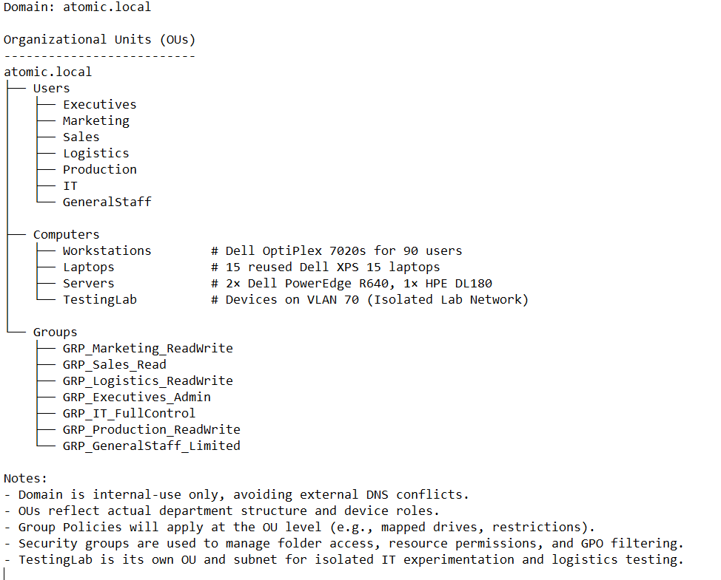
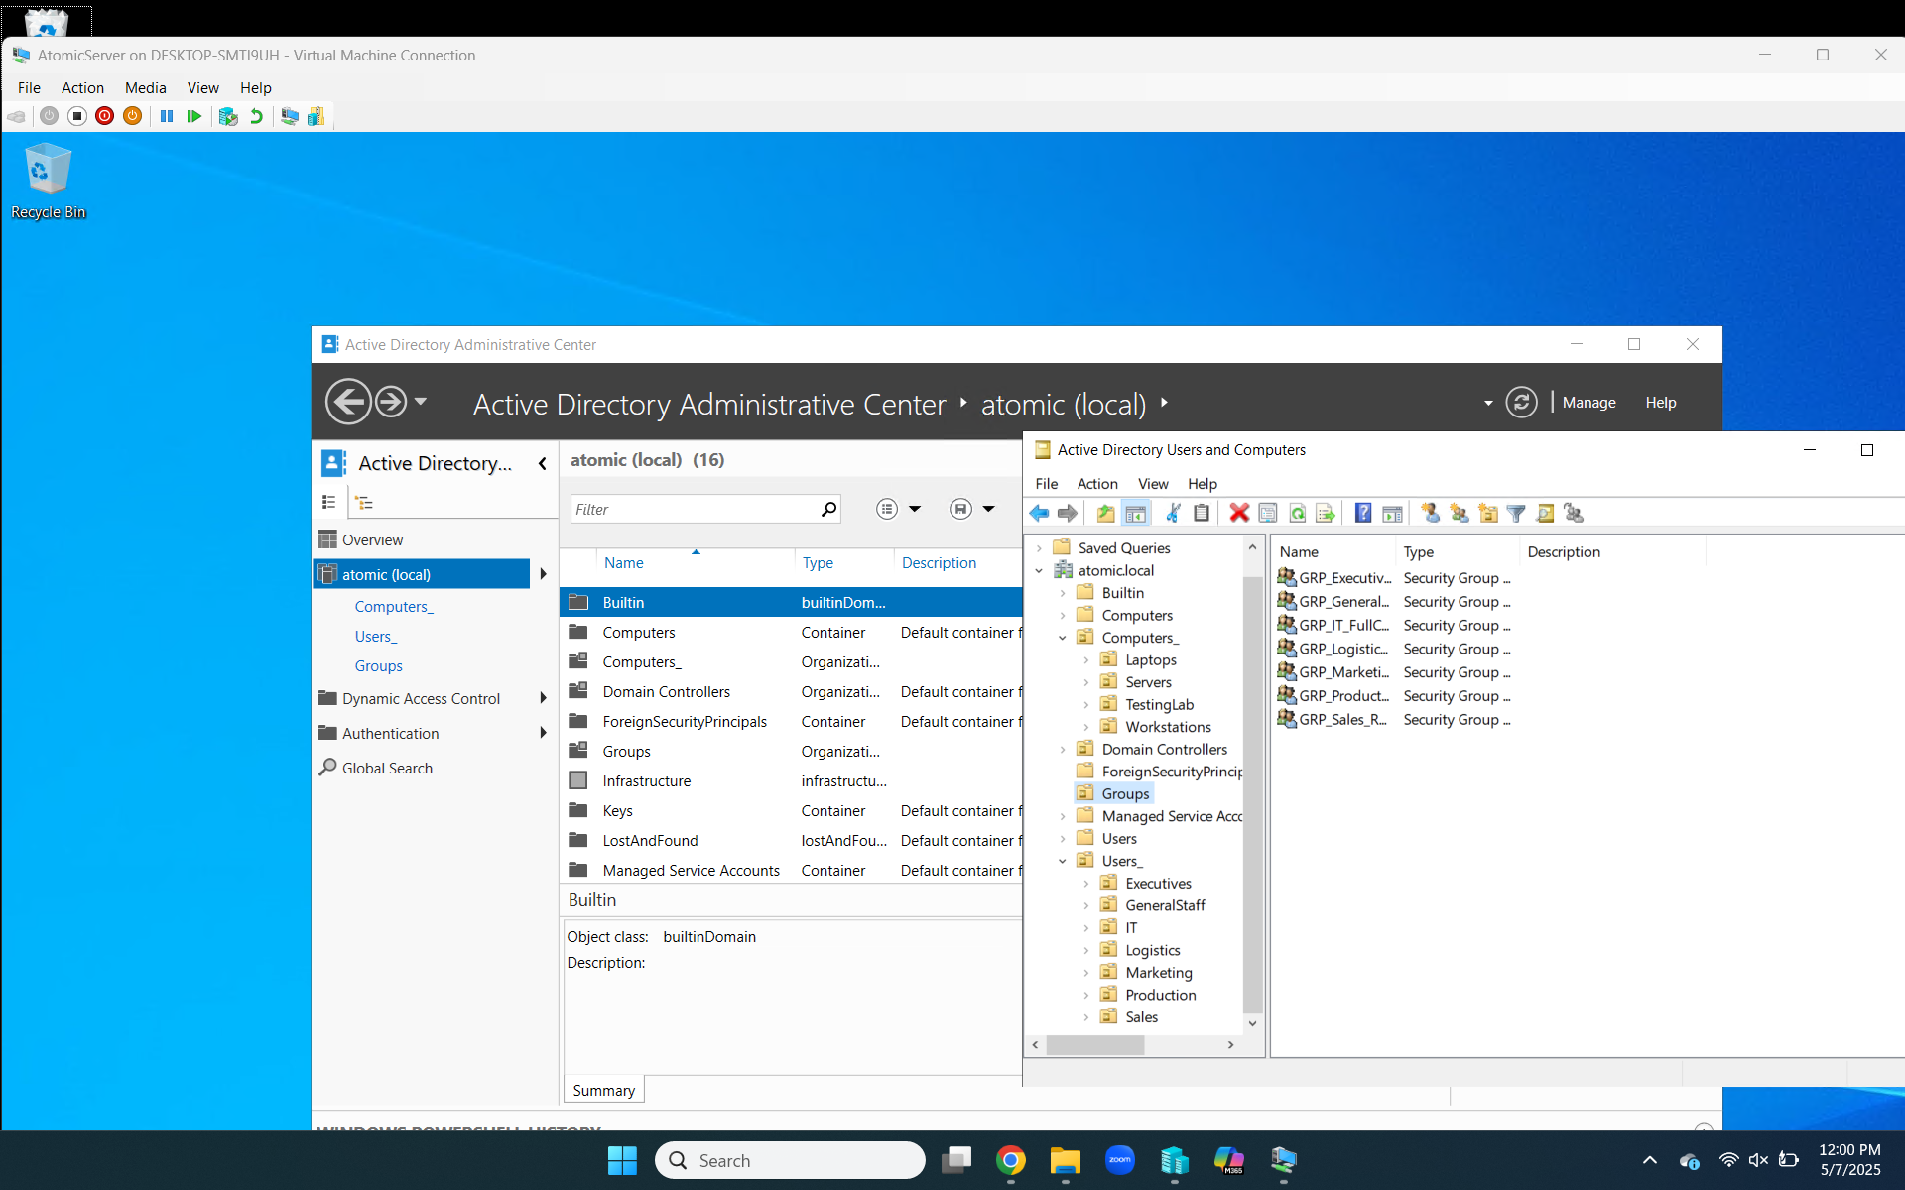
Active Directory Structure
Notes:
Domain: atomic.local (internal-use, DNS-safe)
OU structure built for delegation and scalability
Users by department (e.g. Marketing, Sales, IT)
Computers by device role (Workstations, Laptops, Servers, TestingLab)
Groups for security/access control
Redirected default Users/Computers containers to custom OUs

Slide 10
Groups & Group Policies
Groups
GRP_Marketing_ReadWrite
GRP_Sales_Read
GRP_Logistics_ReadWrite
GRP_Executives_Admin
GRP_IT_FullControl
GRP_Production_ReadWrite
GRP_GeneralStaff_Limited
Group Policies
Password complexity (12+ characters)
Mapped department drives
USB & control panel restrictions
Custom wallpapers by department
Notes:
Created security groups per department (e.g., GRP_Marketing_ReadWrite)
GPOs:
Password complexity (12+ characters)
Mapped department drives
USB/control panel restrictions
Department-branded wallpapers
Group-based access improves scalability and reduces human error

Slide 11
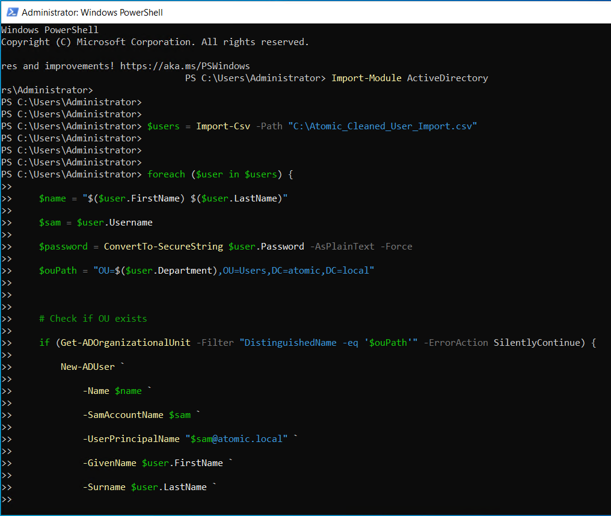
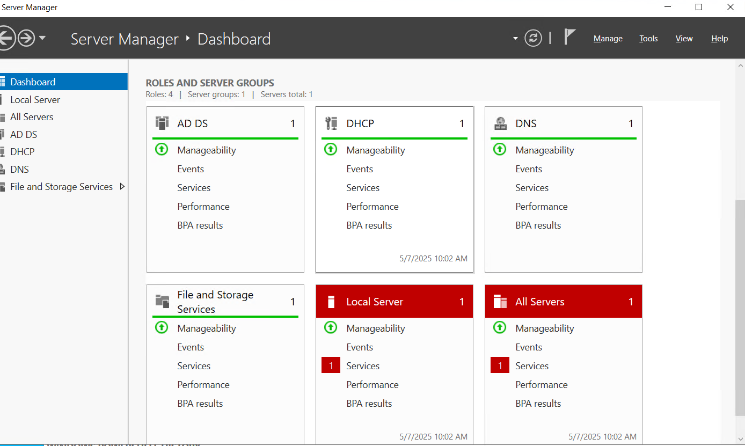
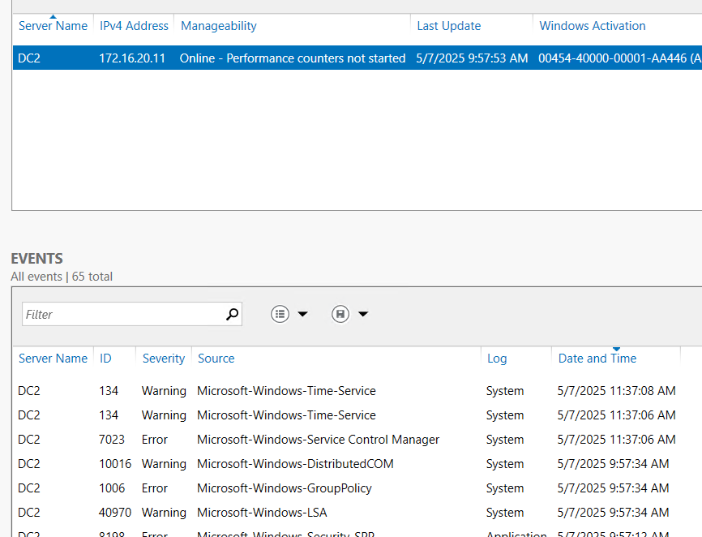
Domain controller implementation
DC1:
IP: 172.16.20.10
Roles: AD DS, DNS, DHCP
DC2 (Redundancy):
IP: 172.16.20.11
Replica Domain Controller
Automation:
PowerShell user import using custom CSV
OU-aware deployment
Notes:
Two domain controllers: DC1 (.10), DC2 (.11)
DC1: AD DS, DNS, DHCP
DC2: Replica domain controller (failover, load balancing)
Used PowerShell script to import users from CSV into department OUs
Automation speeds onboarding, prevents typos, and saves time at scale

Slide 12
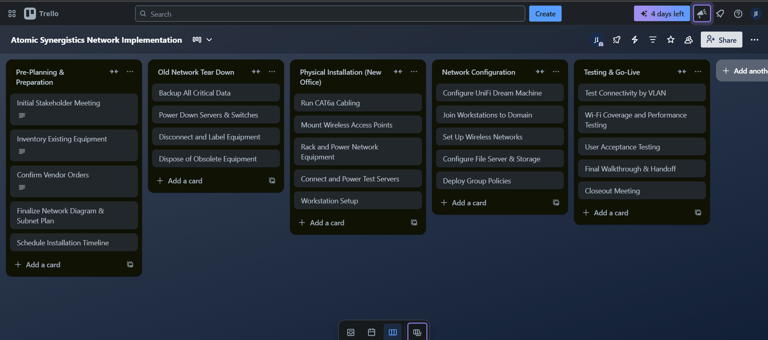
Project Planning & Deployment
Notes:
Used Trello to organize phases: planning, teardown, install, config, go-live
Each phase broken into tasks with timelines and dependencies
Cabling completed before switch/AP deployment
Helped assign work between internal team and vendors
Trello ensured no steps were missed during the transition

Slide 13
Final Recommendations
Centralized, domain-managed environment
Secure, segmented network
Standardized hardware and scalable design
Supports 100+ users and future growth
Prepared for remote access, testing, and collaboration
Notes:
Fully domain-managed, secure, and segmented network
Hardware strategy balances cost and consistency
Enterprise-grade infrastructure ready for 100+ users
Supports remote access, testing environments, future expansion
Atomic now has a reliable foundation to grow on

Slide 14

Thank you
That’s a wrap.
Notes:
Thanks for watching
All project documentation is available upon request
Happy to answer questions or explain any aspect in more detail
This project lays the foundation for long-term IT success

